Slide 1
Rfid guidance system
Submitted by
U.Priyaranjan
Gausic V C
Gopi Krishna J

Slide 2
objective
To design and simulate a guidance system which provides information about places and objects using RFID System.

Slide 3
Introduction
RFID is an acronym for “radio-frequency identification” and refers to a technology whereby digital data encoded in RFID tags or smart labels are captured by a reader via radio waves. RFID is similar to barcoding in that data from a tag or label are captured by a device that stores the data in a database. RFID, however, has several advantages over systems that use barcode asset tracking software. The most notable is that RFID tag data can be read outside the line-of-sight, whereas barcodes must be aligned with an optical scanner

Slide 4
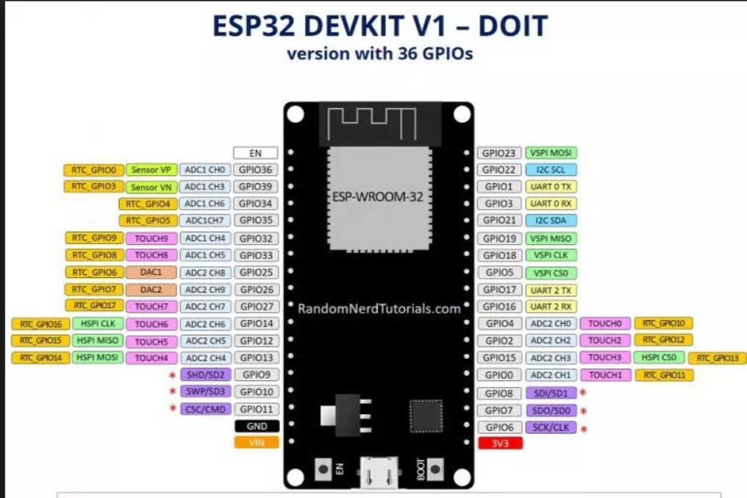
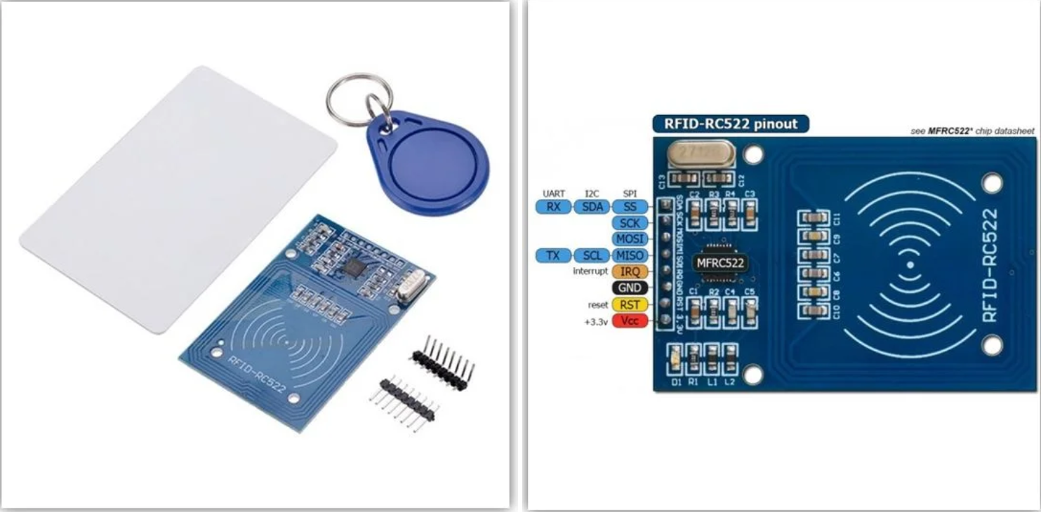
Equipments required
ESP32
RFID RC522
RFID Cards
Connecting wires

Slide 5
Software used
Arduino IDE

Slide 6
Block diagram
DISPLAY
RFID CARDS
Power supply
ESP32
RFID sensor
Database

Slide 7
Working
RFID RC522 scans the rfid cards and shows the data synced to it
RFID scans the cards and via esp32 and displays it in the web page
These method can be used for various applications and places

Slide 8
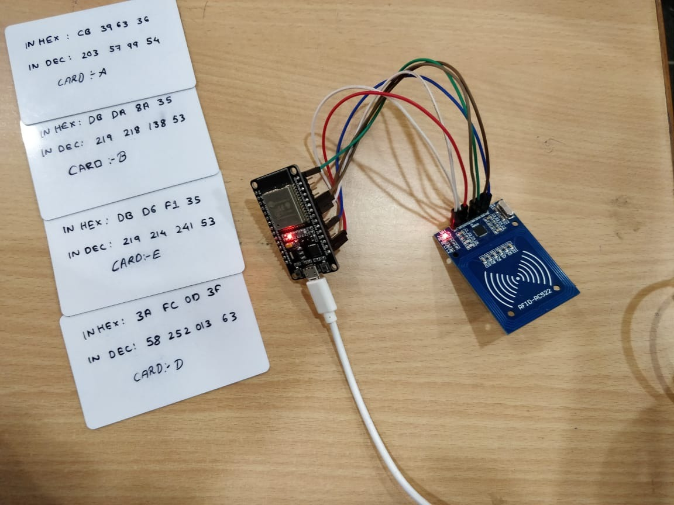
OUTPUT PIcture

Slide 9
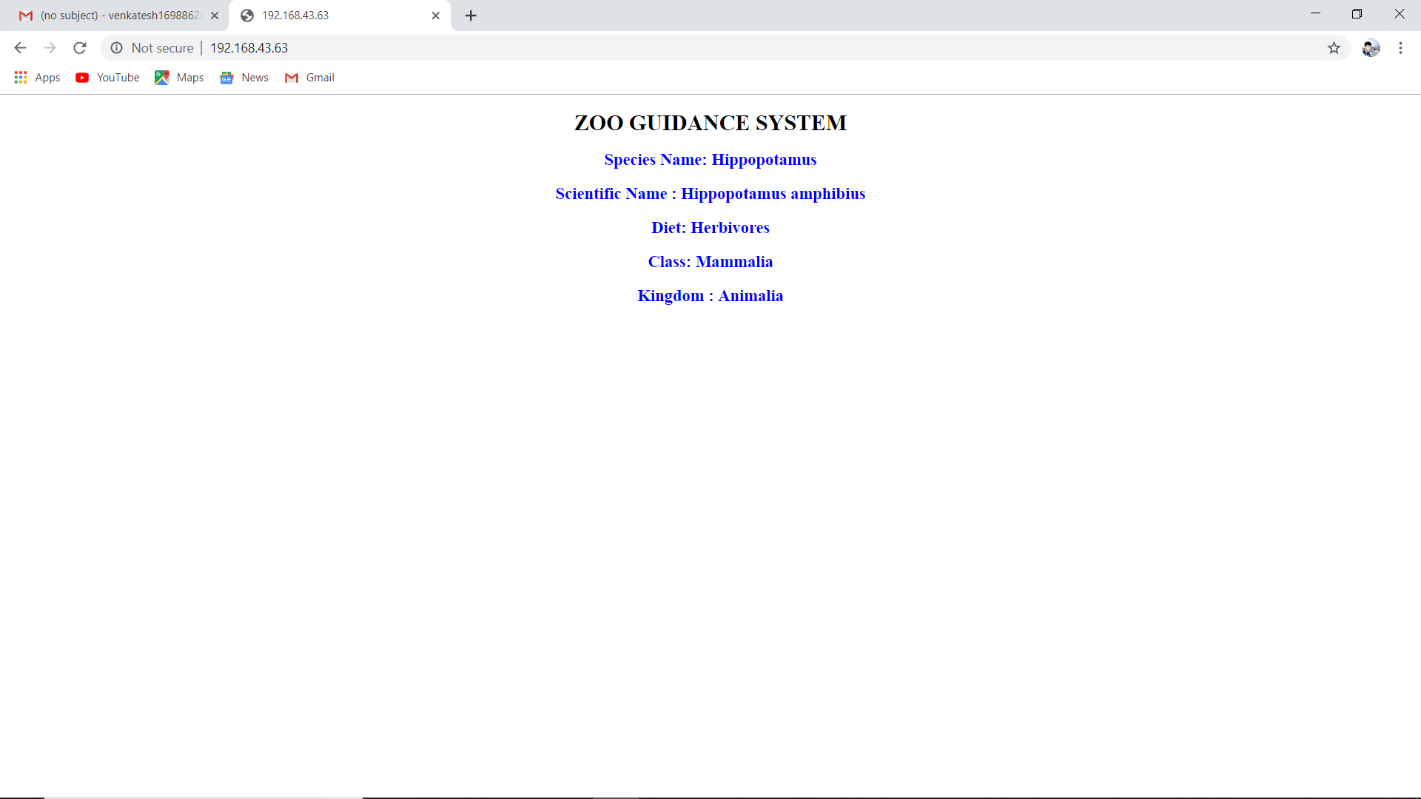

Slide 10
applications
Real-World Applications of RFID
Agriculture
RFID can be useful to track the movement and health of animals on a farm. It ensures that each animal on the farm is consuming the correct food.
Jewelry Tracking
With item-level tagging of jewelry with RFID, it’s possible to track the jewelry right from the factory to the distribution center and, ultimately, to the store. Moreover, this process is both convenient and cost-effective.
Defense
RFID also has a key application in defense. It’s used for weapon and soldier’s movement tracking.

Slide 11
Benefits of rfid
Adds flexibility and intelligence in the process to improve service levels.
Integrated automated receiving PCP in manufacturing enables you to continue without waiting for the receipt of the material.
It enables to control the expiry date, automatic filling of missing files, inventory and returns control, and expedited checkout.
Allows you to check shelves, boxes, and pallets on top without any eye contact.
Reduces the total cycle time order until the goods delivery.
Reduces the errors made in deliveries of customers’ orders.
Allows you to read multiple tags and, hence, increases the reading speed instead of processing one bar code at a time.
Easy monitoring of all logistics operations along with increased security.
Increased speed and agility in locating materials.
Helps in avoiding tampering with the recording of unique codes.
Makes it easy to manage products and materials with less manpower.

Slide 12
Thank you

